Slide 1



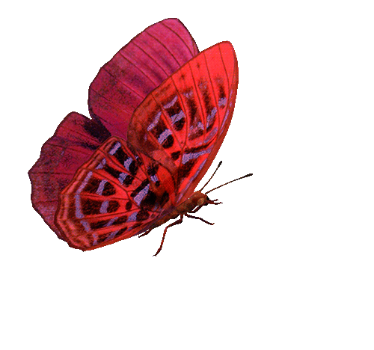



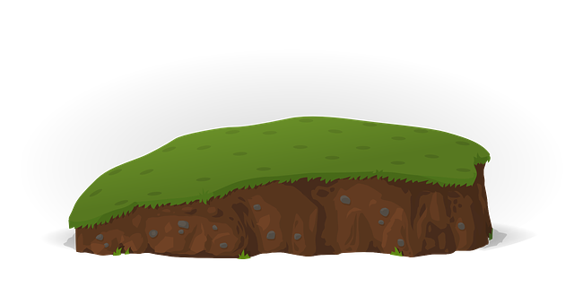



BẮT BƯỚM
Catch a Butterfly
Design by TRO GIANG

Slide 2
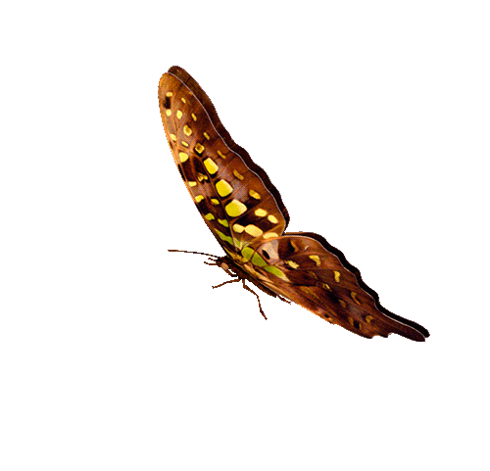


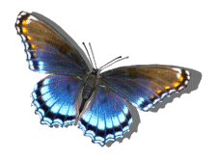




1
5
9
CHÚC MỪNG
ĐỘI A
CONGRATULATIONS
TEAM A
CHÚC MỪNG
ĐỘI B
CONGRATULATIONS
TEAM B
6
8
2
4
10
7
3
1
2
3
4
5
6
7
8
9
10
1
2
3
4
5
6
7
8
9
PIPI
10
TEAM A
TEAM B

Slide 3

Question 1
A. Right
B. Wrong
C. Wrong
D. Wrong
GO HOME

Slide 4
Question 2
A. Wrong
B. Wrong
C. Wrong
D. Right
GO HOME

Slide 5
Question 3
A. Wrong
B. Right
C. Wrong
D. Wrong
GO HOME

Slide 6
Question 4
A. Right
B. Wrong
C. Wrong
D. Wrong
GO HOME

Slide 7
Question 5
A. Wrong
B. Wrong
C. Right
D. Wrong
GO HOME

Slide 8
Question 6
A. Wrong
B. Wrong
C. Wrong
D. Right
GO HOME

Slide 9
Question 7
A. Wrong
B. Right
C. Wrong
D. Wrong
GO HOME

Slide 10
Question 8
A. Wrong
B. Wrong
C. Wrong
D. Right
GO HOME

Slide 11
Question 9
A. Right
B. Wrong
C. Wrong
D. Wrong
GO HOME

Slide 12
Question 10
A. Wrong
B. Wrong
C. Right
D. Wrong
GO HOME

Slide 13

ĐĂNG KÝ TRỢ GIẢNG
GẮN KẾT CỘNG ĐỒNG GIÁO VIÊN
SUBSCRIBE my channel, please

